Slide 1
PARENT NIGHT
Please Sign-In!
Lake in the Hills Elementary School
Second Grade – Miss Sprouse
August 29, 2013

Slide 2
Welcome, Parents!
Welcome: Introduction of myself
Goals for Parent Night
To outline curriculum
To explain behavioral expectations
To detail classroom procedures
To share information about how learning can be supported at home

Slide 3
Poem: Unity
I dreamed I stood in a studio and watched the sculptors there. The clay they used was a young child's mind, and they fashioned it with care.
One was a teacher; the tools he used were books, and music, and art. One, a parent with a guiding hand, and a gentle, loving heart.
Day after day the teacher toiled, with touch that was deft and sure, While the parents labored by his side and polished and smoothed it o'er.

Slide 4
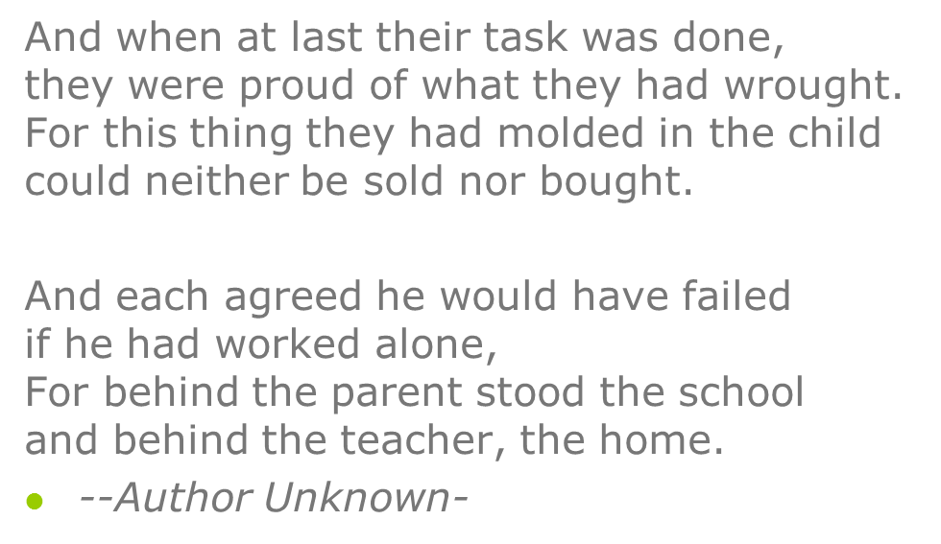
Unity, continued…

Slide 5
My Philosophy on Learning
Each child has the ability to succeed.
Taking into account each student’s strengths/weaknesses when planning.
Children learn best through their ability to explore and apply skills taught.
Variety of visual, auditory, and kinesthetic lessons daily.
Both individual and small group opportunities daily
great for students who enjoy working with others and also for those who work best independently
We are a classroom family, we will all work together, and we will learn from each other daily ☺

Slide 6
Second Grade Curriculum Highlights

Slide 7
Language Arts
Balanced Literacy Approach with a
90 Minute Uninterrupted Reading Block
Guided Reading: small groups
Independent Reading daily (read to self)
Word Study: Vocabulary Word of the Week (Attached Word List), Word Wall Words (Attached Word List), Word Work
Writing: Being a Writer Program (Mon. – Thurs.)
Read-Alouds: Model Reading Strategies
Poetry: Practice Fluency and Expression
Reading Motivators: Incorporating technology, reading to them, going to the library, let them self-select books!
Note: By the end of 2nd Grade, students should know how to read all 220 High Frequency Words. (See attached sheet.)

Slide 8
Writing
Narrative Writing
Expository Writing (research based-President and Animal Reports)
Letter Writing
Flat Stanley project ☺
Persuasive Writing
“Open Mic” on Thursdays-time to share and be proud of their writing ☺
High Emphasis on the “5 Stars” of writing: Capitals, punctuation, spacing, letter formation and spelling.

Slide 9
Mathematics
Based on the NEW Common Core State Standards
Think Deeply – Emphasizes critical thinking. Explain thinking, especially in writing.
Integrate Learning – Emphasizes learning across subject areas.
Show How They Know – Emphasizes proof and evidence. The new tests will also require students to explain how they know. (pictures, written explanation, number sentence/equation)
Emphasis on using manipulatives/tools for learning.
Note: See attached sheets for more information.

Slide 10
Math Units
Fact Strategies (+/-) Up to 20
Place Value to 1,000
Time to the Nearest 5 Minutes
Fluency with (+) and (-) within 100
Exploring (+) and (-) within 1,000
Reasoning with Shapes, Money, and Linear Measurement with Standard Units
Learn (+) and (-) Facts up to 20 by the End of the Year within 2 Minutes
Note: See handout for sample (+) and (-) timed tests.
Expectation by the end of the year is 50 facts in 2 minutes.

Slide 11
Science Units
Energy (fall)
Animals (winter and into spring)
Field Trip in the spring to Randall Oaks
Biomes (spring)
Nutrition-(spring)

Slide 12
Social Studies Units
Communities
Need for Rules and Laws
Government
Historical Figures
Ancient Cultures around the World

Slide 13
Second Step Curriculum
Focuses on Building Social and Academic Skills in Order to Promote a Better learning Environment and Well-Rounded Child.
Promotes a Positive Behavior Support System.
Lesson each Monday

Slide 14
All About Me
Each student will be the “Student of the Week”.
They will get a poster on the Friday before their week to decorate and bring back on Monday. (Posters/pictures returned at the end of that week)
They can choose to participate in daily activities during their week.
List will be on the website soon!-More information in the next newsletter.

Slide 15
Take Home Items
Green Folder-take home for Home Fun, graded work, notes
Blue Folder-reading log
Poetry Binder-goes home on Friday
Assignment notebook-should be filled out each day and signed each night by parent/guardian.

Slide 16
Homework Policy
Promotes Responsibility and Study Skills
Assignments should be written down in Assignment Book
Homework brought home and returned in green folder
Read 20 Minutes Nightly and Practice (+) and/or (-) Facts for 5 Minutes Nightly (Monday – Thursday)
My Focus: what major concepts are understood/not understood.
Incomplete Homework: Student misses a portion of recess in order to complete missing homework.
Homework Completed ALL Week: Student receives a “SPOT” on Friday.

Slide 17
Reading Log
Read for a MINIMUM of 20 minutes each night Monday through Thursday. Completion of the weekly Reading Log meets the requirements of ALL reading incentive programs such as Book It, Ozzie Reading Program, and the Great America reading program. No additional forms are needed.
Please keep all sheets for the month in folder until the month is over.

Slide 18
School Rules
Respect for Self
Respect for Property
Respect for Others
Respect for Teaching
“SPOT” cards are earned in the classroom and throughout the school for following school-wide expectations.
Note: Behavior Matrices are attached.

Slide 19
Classroom Rules
Follow the 4 areas of respect
Raise your hand
Wait your turn
Try your best
Be a “Bucket Filler”
Keep hands and feet to yourself
Be an active listener

Slide 20
Behavior Chart
Green Card=Awesome day! Followed directions and was ready to learn!
Yellow Card=Two verbal warnings were given, 5+ minutes of recess were missed
Red Card=phone call home, all of recess missed, possible contact with Mrs. Poole.

Slide 21
Class Dojo
New tool to manage individual behavior
It is used daily and I try to assign points once or twice a day
Incentive for positive behavior
Different prizes for reaching a certain amount of points.
Points start over one someone reaches the goal.
See parent handout for Class Dojo with code to check their points

Slide 22
Quantum Learning
Teach to the Brain
Use of Color, Music, and Movement
Celebrations of learning
5 Tenets to Teaching and Learning
Everything is on Purpose
Acknowledge Every Effort
Everything Speaks
Experience Before Label
If it is Worth Learning, It’s Worth Celebrating

Slide 23
Classroom Jobs
Students take Ownership of the Classroom
Students have a job every other week.

Slide 24
Schedule
Snack- Daily around 10:00-10:30
Recess- Daily 11:50 - 12:12
Lunch- Daily 12:18 - 12:50
P.E.- Thurs (10:30-11:00) + Fri. 11-11:30)
Music- Mon. + Tues. 11 – 11:30
Computers- Wednesdays 2-2:30
Library- Thursdays 1:45 – 2:00
Will be able to check out 2 books this year.
Art- Fridays 2:00 – 2:30

Slide 25
Snack Time
Daily around 10:00 A.M.
Healthy Snack: No cookies, candy, or chips.
Crackers, cereal, fruit snacks are fine ☺
Must be Able to Eat it Independently so Learning can Continue
Provide Utensils if Needed
Water Bottles are Encouraged
No juice, Gatorade, or Kool-Aide

Slide 26
Birthday Procedure
Birthdays should be Celebrated!!!
Treats must be Pre-Packaged and Store Bought. We have 24 students currently.
Monthly Birthday Lunches with the Teacher
Half Birthdays are Celebrated for June and July Birthdays
Treat Alternatives:
Donate a Book to the Library
Donate a Book to the Classroom
Pass out Pencils, Stickers, etc.

Slide 27
Website and Blog Information
http://misssprouse.weebly.com
Visit the website for classroom information, pictures, and educational websites.
Please email me any pictures you may have of the class/students that you would like on the website.
Students are invited to participate on the blog.

Slide 28
Get Involved!
Join the PTC
Attend Events and Fundraisers
Volunteer Opportunities:
TAP Parents
Mystery Readers-parents, siblings, grandparents, etc.
Party Coordinators
Apple Party and Polar Express

Slide 29
Closing
Parent Night is not a conference. If you want a conference, please let me know, and we’ll set a date and time.
Parents, please collect all handouts off your child’s desk.
Please sign and return the first page of this packet by Tuesday, September 3rd.

